Slide 1
Santa Ana College VOTES 2020!
Voting promotion toolkit
by the
SAC Civic Engagement Team

Slide 2
Important Dates
September 22 – National Voter Registration Day
October 19 – CA voter registration deadline (same-day registration is available)
November 3 – General Election

Slide 3
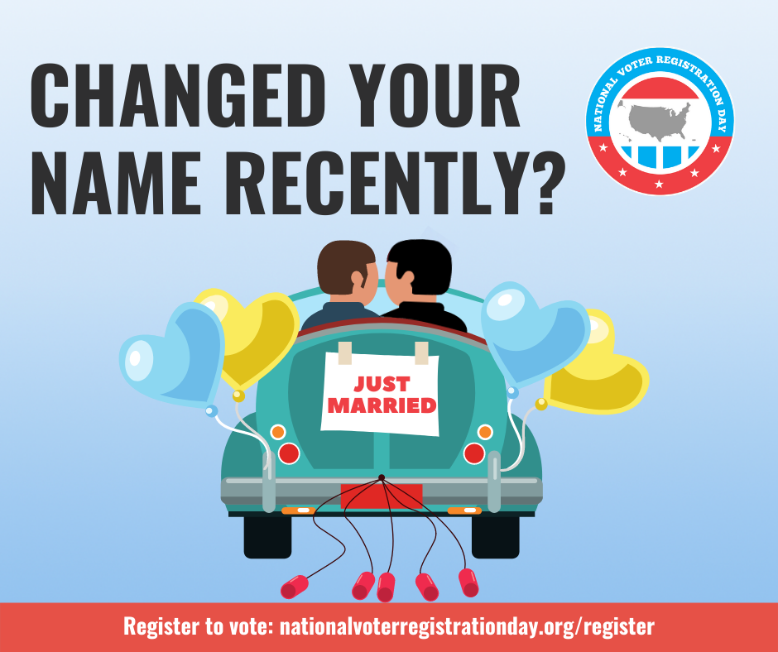
Sample Announcements for Canvas or email
Just copy and paste the image below into your message!
Have you changed your name recently?
Whatever the reason be sure to update your voter registration TODAY!

Slide 4
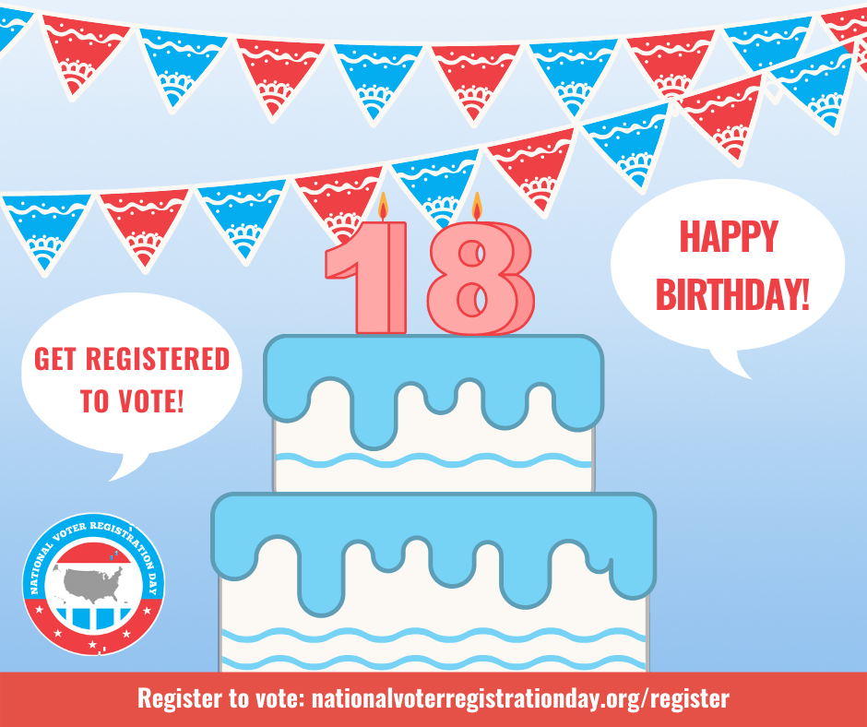
Sample Announcements for Canvas or email
Just copy and paste the image below into your message!
If you have recently turned 18, may we suggest the perfect belated birthday gift? Registering to vote ahead of the November election!

Slide 5
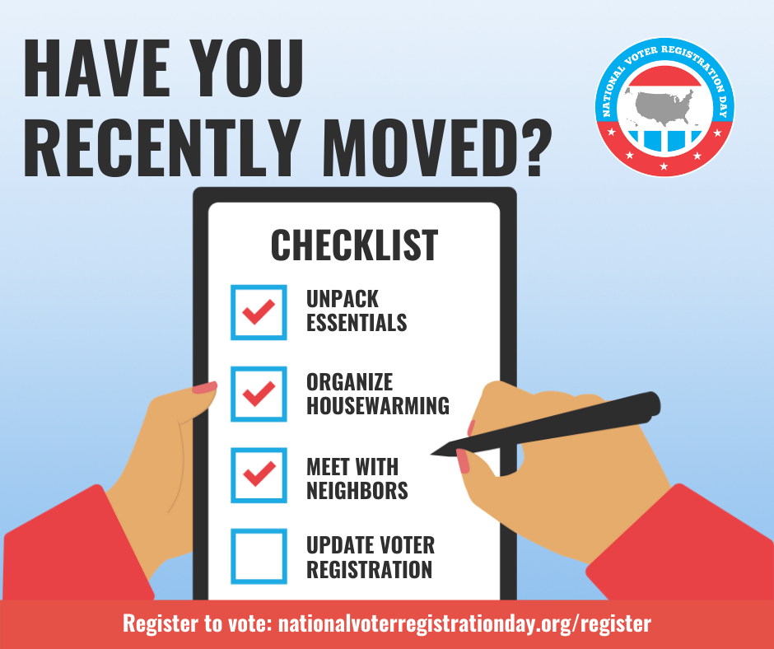
Sample Announcements for Canvas or email
Just copy and paste the image below into your message!
Each year, an estimated 30+ million Americans move. Whether you have moved across the country or down the street, be sure to update your voter registration TODAY!

Slide 6
Copy/paste announcement, suggested date August 31
Fannie Lou Hamer, born in 1917 the youngest of 20 children to Southern sharecroppers, didn’t even know she had the right to vote until she was 44 years old. She suffered threats and physical attacks for attempting to register to vote, which she eventually did.
#registertovote
A 1979 poster made of Hamer, whose voting rights activism transformed the nation. In the quote printed in the top right corner, civil rights lawyer Eleanor Holmes Norton compares Hamer to Martin Luther King Jr. (TABS / National Museum of American History)

Slide 7
Fannie Lou Hamer Video to show students

Slide 8
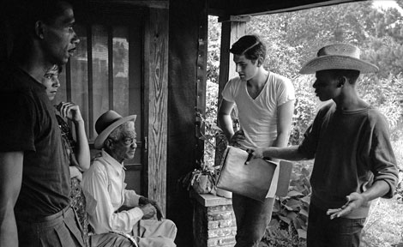
Copy/paste announcement, suggested date September 8
A coalition of civil rights organizations, led by the Student Nonviolent Coordinating Committee (SNCC) and Congress on Racial Equality (CORE), organized a movement they named The Mississippi Summer Project of 1964, later known as “Freedom Summer,” which led the black community to voter registration, participation, and education. Three volunteers, James Chaney, Michael H. Schwerner and Andrew Goodman – one black and two white –disappeared in late June and were found murdered on August 4, 1964 near Philadelphia, Mississippi. The rest of the activists involved with the project were beaten, threatened and arrested throughout the summer. These groundless and severe actions were all related to the simple actions by volunteers to register eligible voters.
#registertovote
Freedom Summer volunteers urge a Mississippi man to register to vote. Although 17,000 black residents submitted applications, local registrars rejected all but 1,600 applications. (Photo by Ted Polumbaum, courtesy of the Newseum)

Slide 9
“Freedom Summer” by American Experience to show students

Slide 10
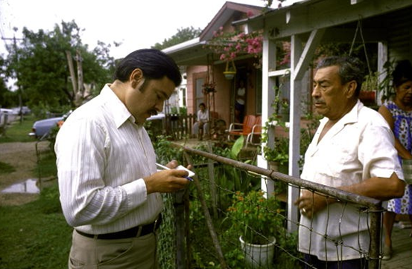
Copy/paste announcement, suggested date September 15
Willie Velásquez, poltical activist and founder of the Southwest Voter Registration Education Project, registers a man to vote. Since SVREP's founding in 1974, Latino voter participation has nearly tripled to 14.3 million as of 2019.
Southwest Voter Registration Education Project (SVREP) was founded in 1974 by San Antonio native Willie Velásquez and other Mexican American political activists to encourage Mexican Americans in the Southwest to vote. Since then, SVREP has grown into the largest and oldest nonpartisan Latino voter participation organization in the country. Because of its efforts, Latino voter participation has nearly tripled, from 5.4 million in 1994 to 14.3 million today.
#registertovote
#suvotoessuvoz

Slide 11
Copy/paste announcement, suggested date September 22

Slide 12
Virtual Zoom backgrounds
To save and use this image:
1: Right click (or control/click)
2: choose “Save as picture”
3: In ConferZoom, with your Zoom window open, click the right up arrow next to the “Stop Video” icon
4: Select “Choose Virtual Background”
5: Click on the plus sign to the right, “Add image or Video”
6: Select and upload the image

Slide 13
Virtual Zoom backgrounds
To save and use this image:
1: Right click (or control/click)
2: choose “Save as picture”
3: In ConferZoom, with your Zoom window open, click the right up arrow next to the “Stop Video” icon
4: Select “Choose Virtual Background”
5: Click on the plus sign to the right, “Add image or Video”
6: Select and upload the image

Slide 14
Virtual Zoom backgrounds
To save and use this image:
1: Right click (or control/click)
2: choose “Save as picture”
3: In ConferZoom, with your Zoom window open, click the right up arrow next to the “Stop Video” icon
4: Select “Choose Virtual Background”
5: Click on the plus sign to the right, “Add image or Video”
6: Select and upload the image

Slide 15
Virtual Zoom backgrounds
To save and use this image:
1: Right click (or control/click)
2: choose “Save as picture”
3: In ConferZoom, with your Zoom window open, click the right up arrow next to the “Stop Video” icon
4: Select “Choose Virtual Background”
5: Click on the plus sign to the right, “Add image or Video”
6: Select and upload the image

